Slide 1
Brain Tumor Classification (MRI)
A2 Portfolio 2

Slide 2
Agenda
Introduction
Methodology
Result and Findings
Conclusion

Slide 3
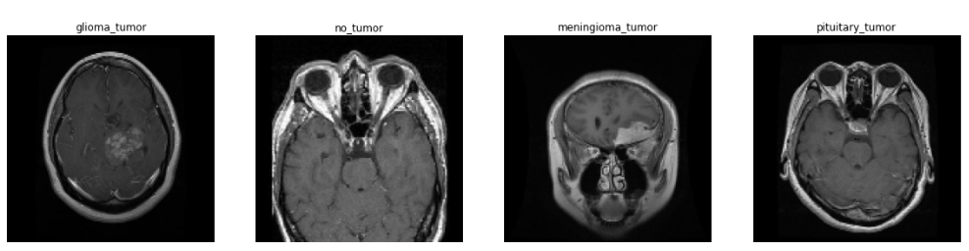
Introduction
To classify the image if the patient have brain tumor or not and what type of brain tumor does patient have.
We used Brain Tumor Classification (MRI) as our datasets.
There are 4 classes in the data sets i.e.
0 -Glioma Tumor (826/100) 1 - No Tumor (327/98) 2 - Meningioma Tumor (246/127) 3 - Pituitary Tumor (827/98)

Slide 4
Methodology
Using CNN’ EfficientNetB0 model.
We used 3 layers i.e. GLobalAveragePooling2D, Dropout, and Dense
GlobalAveragePooling2D utilizes Average values rather than Max values while pooling.
Trainable parameters are 4,012,672.
The used hyper parameter is epochs.
12 epochs used for training.

Slide 5
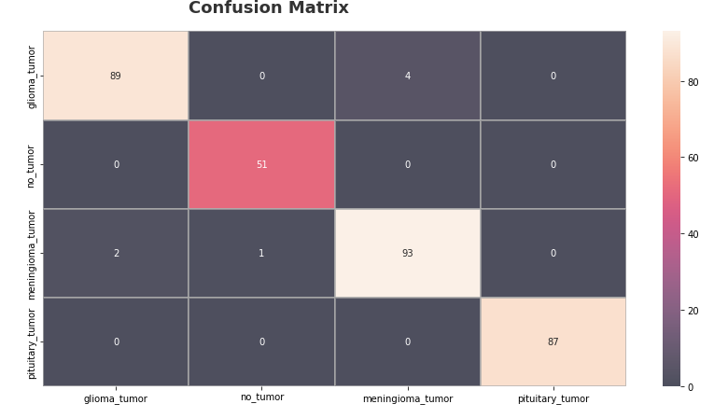
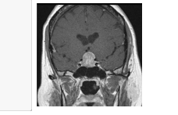
Result and Findings
Used confustion matrix for Glioma Tumor, No Tumor, Meningioma Tumor, 3 - Pituitary Tumor.
The model was predicted by uploading the image. The predicted image showed pituitary type tumor.

Slide 6
Conclusion
By evaluating the type of brain tumor as Glioma Tumor, No Tumor, Meningioma Tumor, Pituitary Tumor by confusion matrix now the system can predict any tumor, if there is no tumor it will predict no tumor.
By using CNN, in Image classification the accuracy of prediction gives around 98%.
Thank you

